Slide 1
Recursive Function for n!
What do we know about n!?
n! is defined for non-negative integers [0, ∞)
n! = n * (n – 1) * (n – 2) * … * 2 * 1
= n * (n - 1)!
0! is defined to be 1
What is the base case?
n = 0 0! = 1
What is the recursive case?
n > 0 n! = n * (n – 1)!

Slide 2
How Does Recursion Work???
factorial(3)
factorial(2)
factorial(1)
n = 3
n = 2
n = 1
return
n * factorial(2)
n * 2 = 6
return
n * 1 = 2
n * factorial(1)
return
n * factorial(0)
n * 1 = 1
def factorial(n):
# check for the base case
if n == 0:
return 1
# handle the recusive case
return n * factorial(n - 1)
print(factorial(3))
print(6)

Slide 3
Fibonacci Sequence
What is a Fibonacci Sequence?
F₀ = 0
F₁ = 1
F_{n} = F_{n-1} + F_{n-2}
What is the base case?
F₀ = 0
F₁ = 1
What is the recursive case?
F_{n} = F_{n-1} + F_{n-2} (n > 1)

Slide 4
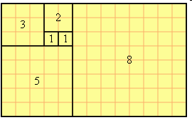
Fibonacci Sequence
F_{n} = F_{n-1} + F_{n-2}
0, 1, 1, 2, 3, 5, 8, 13, 21, 34, 55, 89, ...

Slide 5
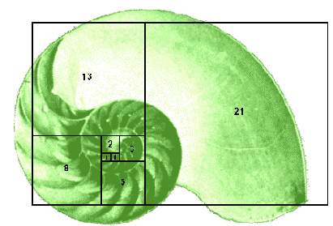

Slide 6
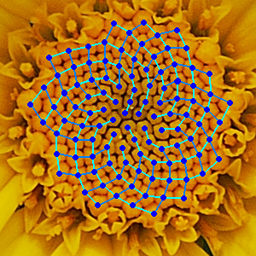

Slide 7
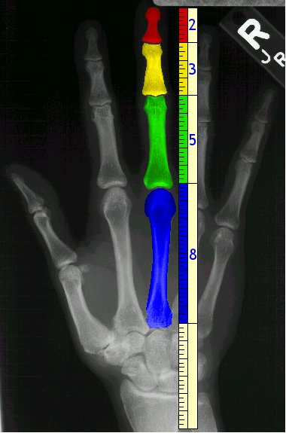

Slide 8
Observations on Problem 5
We want to convert 483 from decimal to hexadecimal, so we call our function:
convert_10_to_16(483)
Inside the function we need to go through the process outlined in the assignment:
483 / 16 = 30 R3
Note that all hexadecimal numbers should be strings
Convert to hexadecimal digit
Convert from base 10 to base 16

Slide 9
2-Dimensional Lists
Python lists are an example of what is more generally called a “container class”.
Essentially, lists are containers for any kind of variable you would like to store in them – including other lists.
For example:
my_list = [0, '1', True, None, 5.43]
my_list = [1, ['a', 'b', 'c'], 3.14, None, ('X', 6, 'Z'), False]
my_list = [99, ['a', [6, 16, 3], 4.44], [True, ['1', 'b']], 'k']

Slide 10
2-D lists (cont.)
How do we access the various elements of my_list = [99, ['a', [6, 16, 3], 4.44], [True, ['1', 'b']], 'k']?
my_list[0] = 99
my_list[1] = ['a', [6, 16, 3], 4.44]
my_list[2] = [True, ['1', 'b']]
my_list[3] = 'k'
What about the elements of my_list[2] = [True, ['1', 'b']]?
my_list[2][0] = True
my_list[2][1] = ['1', 'b']
What about the elements of my_list[2][1] = ['1', 'b']?
my_list[2][1][0] = '1'
my_list[2][1][1] = 'b'

Slide 11
Databases
What is a database?
An organized collection of data
Examples:
Library
Bank
Business
University

Slide 12
Databases (cont.)
How is data stored in a database?
In simple databases, data is often stored in records.
What is a record?
All the necessary information about a single item, stored in various fields.
What is a field?
Each different piece of information about any specific item is called a field.

Slide 13
Databases (cont.)
Library Example:
A book record might contain the following information:
Title: ‘Dynamic fracture mechanics’
Author: ‘L. Ben Freund’
Publisher: ‘Cambridge University Press’
Year published: 1990
Call number: ‘TA409.F77’
Location: ‘Morris Library’
Status: ‘Checked out’
This record includes fields for:
Title, Author, Publisher, Year published, Call number, Location, and Status

Slide 14
Database (cont.)
We can store a book record in Python by using a list:
book = ['Dynamic fracture mechanics’,
'L. Ben Freund’,
'Cambridge University Press’,
1990,
'TA409.F77’,
'Morris Library’,
'Checked out']

Slide 15
A Library Database with 6 Books
book = [['Ant and Bee', 'Angela Banner', 1950, 'AB24'],
['Dice', 'Ricky Jay', 2003, '51502713'],
['Flatland', 'Edwin Abbott Abbott', 1880, 'EA91'],
['naked', 'David Sedaris', 1997, 'DS132'],
['The Great Bridge', 'David McCullough', 1972, 'TG25.N53 M32'],
['The TEXbook', 'Donald Knuth', 1984, '9322854']]
book[2] = ['Flatland', 'Edwin Abbott Abbott', 1880, 'EA91']
book[5] = ['The TEXbook', 'Donald Knuth', 1984, '9322854']
Title of book[4] = book[4][0] = 'The Great Bridge'
Author of book[1] = book[1][1] = 'Ricky Jay'

Slide 16
Puzzle
Read in a file containing a database of dogs, that includes name, breed, age and weight. Print out the database. The fields are separated by commas. Age is an int and weight is a float.
Database record:
name,breed,age,weight

